Slide 1


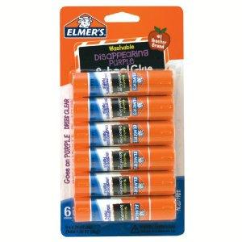
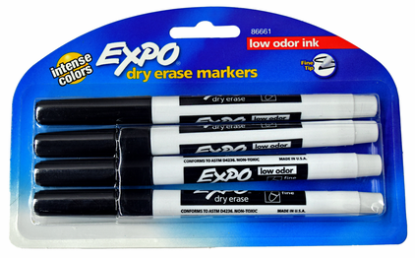
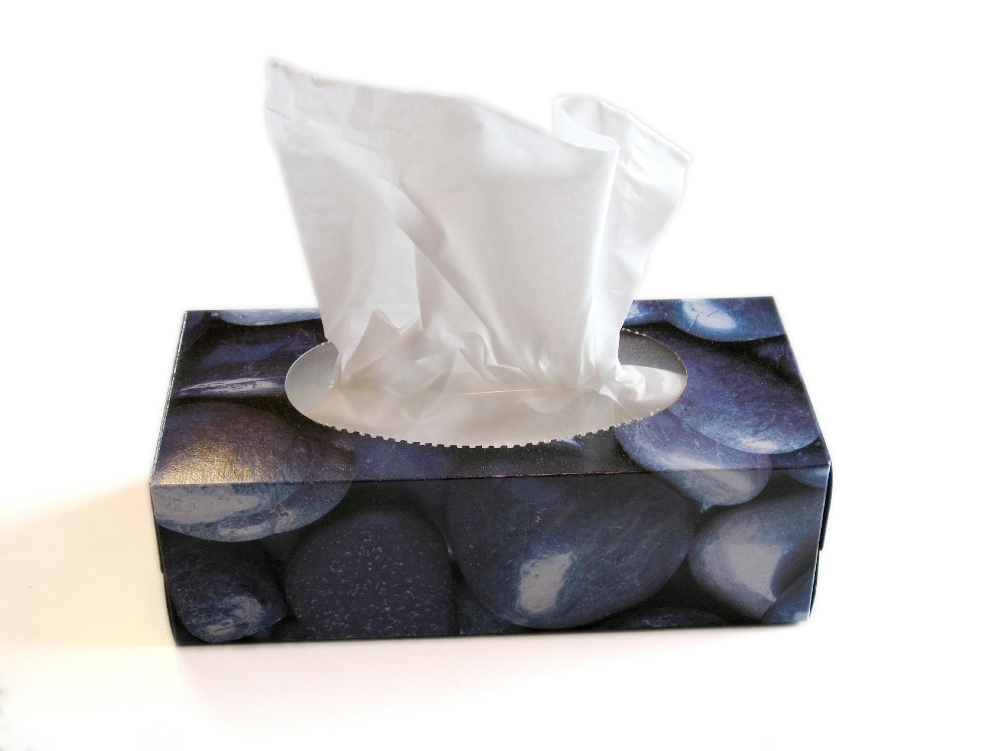
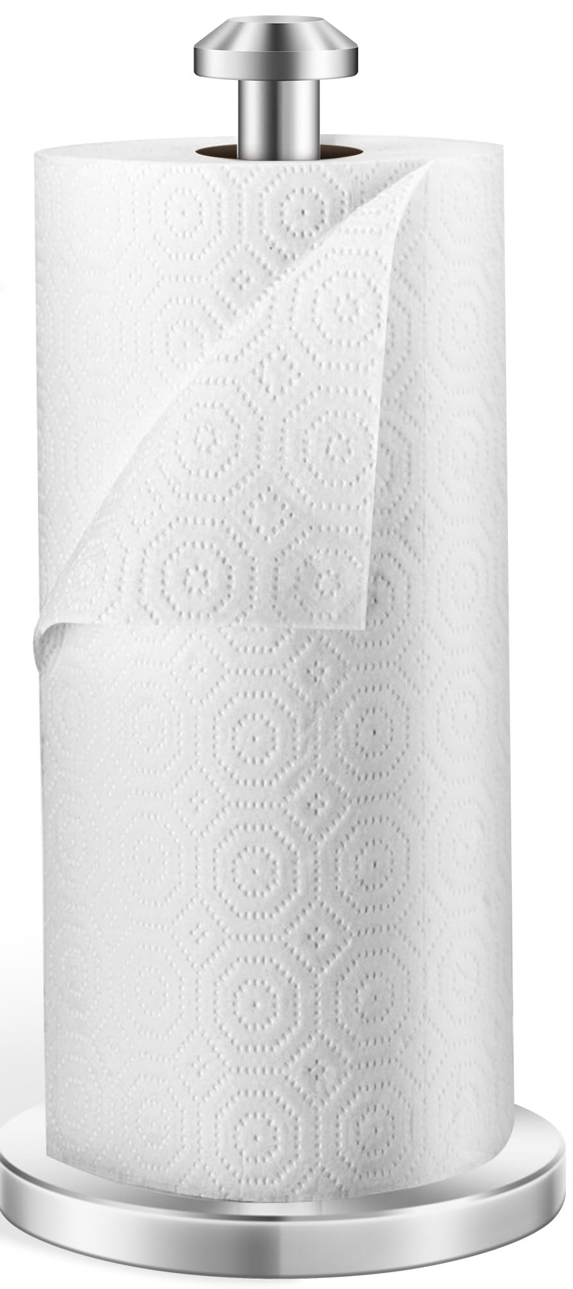
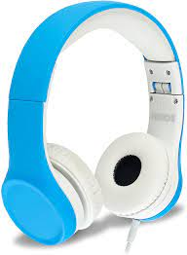
Room 126 Supply List
All students should have a backpack without wheels. The following is a list of completely optional items for your child to bring on the first day of school. All school supplies are for our classroom community to share so do not buy anything specific for your child. We sit at tables instead of desks. Please, do not send in pencil boxes as we do not have anywhere to store them. If you choose to purchase, only send in the listed items. There is also a list of supplies that would be great to have for at-home use throughout the year.
-Mrs. Hoar
Classroom Use:
Glue sticks (please no “smelly” ones)
Black, fine tip dry erase markers (please no colors)
Box of tissues
Roll of paper towels
Headphones (no Bluetooth) - I have headphones for
students to wear in the classroom.
Home Use:
Crayons
Child scissors
Pencils
Glue sticks

